Slide 1
Learn To Program
by Jason Chalom and
Wits SoftDev Student Interest Group 2014
Version 1.0

Slide 2
License
The MIT License (MIT)
Copyright (c) 2014 Jason Chalom, and The Mathematical Sciences
Department of The University of the Witwatersrand (Wits Software Development Student Group).
Permission is hereby granted, free of charge, to any person obtaining a copy of
this documentation and associated software, to deal in
this documentation and associated software without restriction, including without limitation the rights to
use, copy, modify, merge, publish, distribute, sublicense, and/or sell copies of
the Software, and to permit persons to whom the Software is furnished to do so,
subject to the following conditions:
The above copyright notice and this permission notice shall be included in all
copies or substantial portions of this documentation and associated software.
THE DOCUMENTATION AND ASSOCIATED SOFTWARE IS PROVIDED "AS IS", WITHOUT WARRANTY OF ANY KIND, EXPRESS OR
IMPLIED, INCLUDING BUT NOT LIMITED TO THE WARRANTIES OF MERCHANTABILITY, FITNESS
FOR A PARTICULAR PURPOSE AND NONINFRINGEMENT. IN NO EVENT SHALL THE AUTHORS OR
COPYRIGHT HOLDERS BE LIABLE FOR ANY CLAIM, DAMAGES OR OTHER LIABILITY, WHETHER
IN AN ACTION OF CONTRACT, TORT OR OTHERWISE, ARISING FROM, OUT OF OR IN
CONNECTION WITH THE SOFTWARE OR THE USE OR OTHER DEALINGS IN THE SOFTWARE.

Slide 3
Objectives of this Tutorial
Learn basic coding principles for imperative languages
Learn what an algorithm is
Think algorithmically
Do examples in MatLab
Take a problem and be able to map it to a programed solution
Be able to use and understand documentation for further learning

Slide 4
Why would you want to learn to code?
Programming is used in many industries and jobs, for instance in banking all the financial models are programmed. SAS is an example of a statistical language geared towards that kind of computation.
Programming is more than just some mathematical technique. It is a way of algorithmically thinking about problems and their solutions. One important change in thought is breaking down a problem into its base components which you then solve to solve the whole problem. (Abstraction)
Being able to transmute a problem from a definition, equation or implicit overview to a solid algorithm which is able to solve that problem gives you a unique and in-depth understanding of that problem.

Slide 5
Before we begin
This tutorial will go over programming basics using MatLab. MatLab is an imperative programming language which is a way of expressing a program via a set of statements which describe how the problem should be solved.
MatLab is also an interpretive language which means it executes statements directly rather than first converting code into some more advanced code such as assembly or binary.
Keep in mind that there are other types of programming languages which work very differently. The kind of language used depends of the problem and situation. In business the best, fastest and most beautiful solution would mostly be too time consuming and costly to implement, debug and use.
MatLab is a programming language designed to be used to solve mathematical problems. It will not be the kind of language used to make the next text editor or some such program. MatLab is geared towards using matrices. That is its strong suit. Mathematica is more powerful in other areas as a mathematical programming language.

Slide 6
Before we begin
MatLab is quite cost-prohibitive. As a student you will most likely have access to discounts, free versions or local copies at the University.
There is a free open-source alternative which is very similar to MatLab called Octave. It uses the same syntax and is very similar. However there are differences which mainly have to do with more advanced features of MatLab not covered in this tutorial.
Something to lookup would be source control. If you are doing a group project or have many versions of source code for the same project source control can help keep things tidy and simple. GitHub is my personal favourite source control and variant of the git system. (See: https://github.com/edu, http://nvie.com/posts/a-successful-git-branching-model/)
Also Remember DON’T PANIC!

Slide 7
Some conventions and standards
I prefer to use self-documenting code which means that rather than writing pseudo-code or comments explaining what my code does, the code itself is written in an easily readable way. I do sometimes write a block of comments above my code for documentation, especially when I am doing something very mathematical and I'm reasoning my way through it.
I prefer to use spaces in places where they don’t affect the code but rather make the code look nicer and easier to read. I do the same for new lines (Enter).
There are many conventions and ways of writing code which comes with practice. When you are not sure, first look online (sites like www.stackoverflow.com and official documentation: http://www.mathworks.com/help) help to clarify problems and standards, if you still don’t know then ask someone for help. With programing always try to do research first.

Slide 8
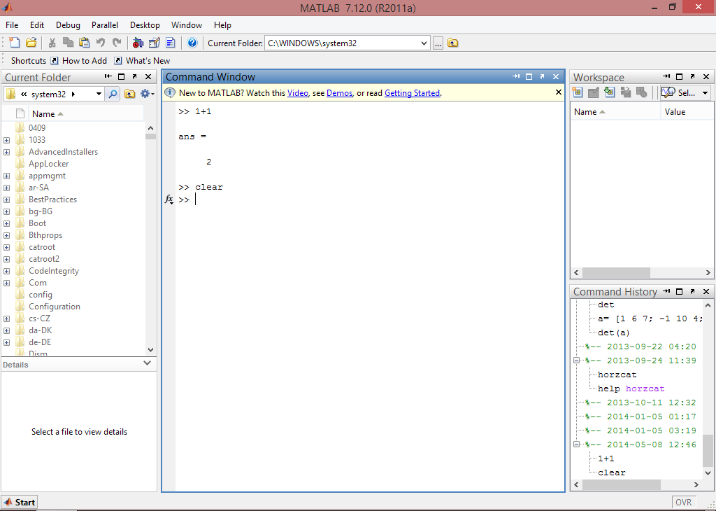
Part I: Basic Interpretive Programming
This is the command line or command window
Ok lets begin:
With an interpretive language like MatLab, you have two ways to execute commands.
By typing in a command and pressing enter at the command line where it will be executed right away
Or by writing a script file and then executing the code in a block.
First we familiarise ourselves with the command line.
Open MatLab
This is the workspace box which shows you variables in memory and what variables are assigned to them
This is the history box which shows you past code which has been executed.

Slide 9
Part I: Basic Interpretive Programming
There are many operators in MatLab, Here is a short list of ones you would come across.
The basic ones are (+ - / *). Plus, minus, divide and times
^ denotes help
= is an assignment operator used to assign one entity to another (This is not equals which is a Boolean operator)
Boolean operators return true/false or 1/0
== is equals
~= is not equals
Logical Operators:
| is OR (UNION)
& is AND (INTERSECTION)
|| conditional OR (for use with Booleans)
&& conditional AND (for use with Booleans)
Special characters:
: (colon) creates an auto generated list.
There are two or three required values
(starting number):(end number)
(starting number):(stepping size):(end number)
This can be used with matrices and also generates vectors
Dot (pointwise operators)
The .^ is a pointwise power (i.e. for each element). This is used in a matrix.
The .* is a pointwise product
The ./ is a pointwise divide
The .+ is a pointwise addition

Slide 10
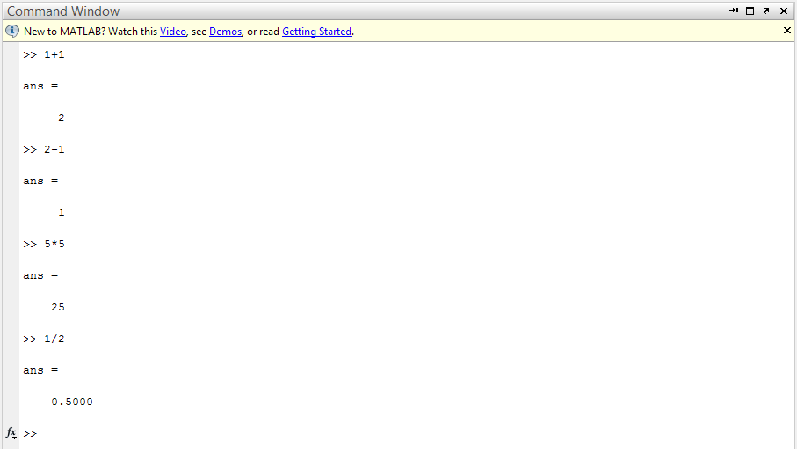
Part I: Basic Interpretive Programming
Try type in and then press enter
1+1
2-1
5*5
½
‘hello’
The last one is known as a string. The ‘’ tells MatLab that it is not a function or command but rather text to be outputted.
Now type clc to clear the command window. clear all will clear the ‘memory space’ storing all variables and answers. The workspace window will be cleared. Using clear ‘name of variable’ (without quotes) will clear only that variable.

Slide 11
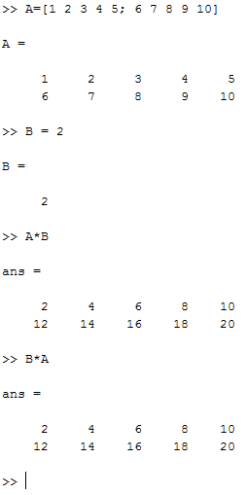

Part I: Basic Interpretive Programming
A variable is an entity which can be associated with a specific value. This can even be a matrix
Try:
A=33
B=10
A*B
Now:
clear all
clc
A=[1 2 3 4 5; 6 7 8 9 10]
B=2
B*A
If you put a ; at the end of the statement it will supress the message output.
Press ctrl-c to terminate any executing code if it is stuck or infinitely executing.
A function I will mention now is the help function.
help ‘any command, operator or topic’
This will display help topics and documentation
In MatLab calling a variable is quite easy. Just using
alpha-numeric characters and an assignment will create
a stored variable. You can also create specific variables i.e.
an Integer but that is a bit harder and usually not needed.
The ; here denotes the end of one line and start of
The next.

Slide 12
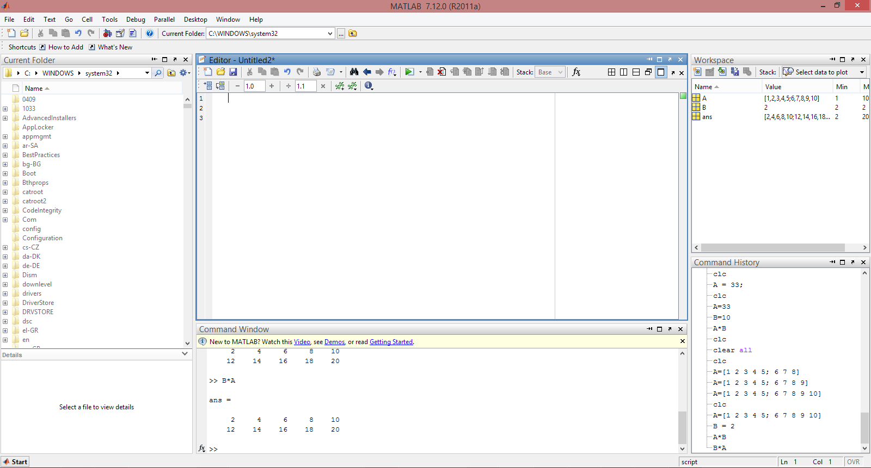
Part I: Basic Interpretive Programming
Now we will start with scripting
File -> New -> Script (Or the new icon)
Later on we will go over functions.
As you see a new window is opened in MatLab
A script is a file which stores a whole collection of related commands which are then executed together. (For this tutorial the code will execute sequentially MatLab does support more advanced code execution like multi-threading)
You can save and open scripts
To run a script click on
Or press F5
Comments are created by putting % in front of any text or numbers. They turn green.

Slide 13
Part I: Basic Interpretive Programming
Before an example with scripts can be done some more basics need to be given.
The condition statement or if-statement is a statement which will execute one command if some condition is met or will execute something else if that condition is not met.
if (expression)
statements
elseif (expression)
statements
else
statements
end
An example would be:
A=2;
if (A == 1)
fprintf('hello');
elseif (A == 10)
fprintf('goodbye');
else
A = 1;
end
The end statement is to tell MatLab to end a block of code. We will use this later for functions.
This example shows the difference between = and ==
fprintf is a function to print text onto the screen (command window), this will be covered later.

Slide 14
Part I: Basic Interpretive Programming
An example would be:
variable = 'hello';
switch (variable)
case 'goodbye'
fprintf('cheers\n');
case 'hello'
fprintf('hello world\n');
otherwise
fprintf('why you say no hello?\n');
end
The end statement is to tell MatLab to end a block of code. We will use this later for functions.
Here the condition is implied and can only be a equal truth condition.
The otherwise code-block is a default code-block you can choose to add in so that if none of the statements are true this one will execute by default.
A SWITCH-CASE statement is similar to the if-statement.
Conditions here are used to execute one set of statements from several different cases pertaining to one specific variable.
Computationally the switch-case statement is slower than the if-statement due to how the computer handles the behind-the-scenes code. It is more useful to use to create more readable and user-friendly code
switch (variable to check)
case (a condition which the variable equals)
The code to execute
Case (another condition which the variable equals)
More code
otherwise
Code for the default case
end

Slide 15
Part I: Basic Interpretive Programming
Loops:
There are two basic kinds of loops, the for-loop and the while-loop
The while-loop is a loop which has a terminating condition. When this condition is met it will terminate.
Usually the terminating condition uses a variable which has been defined before the loop code-block. In the example it’s the count variable.
The loop will continue to execute until the condition stops being true
In Boolean logic a condition where the statement hold is seen as true.
When using the not operator ~ this makes any statement the opposite so here the loop will end when the statement is the opposite i.e. true.
while (condition)
Code to repeat
end
An Example would be:
count = 0;
while (count ~= 5)
count = count + 1
end

Slide 16
Part I: Basic Interpretive Programming
The for-loop is a loop which goes from a defined start point to a defined end point. There is also a counter which can be set to increase or decrease.
The interesting thing about it is that the end condition does not have to be connected to the counter meaning it can be used similar to a while loop although this is not advised.
for index variable = start index : end index
Code to repeat
end
An example would be:
A = zeros(5,100);
for m = 1:5
for n = 1:100
A(m, n) = 1/(m + n - 1);
end
end

Slide 17
Part I: Basic Interpretive Programming
Included with this tutorial are some example scripts. The one with examples from before is called Script1.m It can be opened and executed in MatLab.

Slide 18
Part I: Basic Interpretive Programming
Functions are an important part of any imperative programming language.
Just like in mathematics you can get a function with one or even many variables which are ‘sent into’ the function and a result of some kind is returned the same is true for programming.
f(x) = x²
Programming is a mathematical discipline and follows similar rules to some respect.
A function in MatLab is a type of script. There are others but this tutorial will not go over them.
Functions are used for abstraction purposes.
A function reduces the amount of code needed by taking repeated code and putting it in one place.
It also allows a programmer to break up a difficult problem into smaller bits which makes that problem easier to understand.
There are many functions in MatLab which can help make things easier.
There are two ways of declaring functions in MatLab.
Where there is one output
Where there is multiple outputs

Slide 19
Part I: Basic Interpretive Programming
Declaring Functions with one output:
function output variable = function name(input variable/s)
Any kind of code
output variable = some value or computation;
Any kind of code (Although not outputted from FN)
end
In MatLab the function name has to be the same name of the m file it is stored in.
Usually the function is stored in its own file but you can have a script and a function together. (see later)
A script or another function in a different file or even the command window can access and use a function within those computations.
It just needs to be open in MatLab, or be in a recognised path. (Dialogue when you try to run it with F5 or the run button)
An Example:
function y = average(x, z)
if isvector(x)
error('Input must not be a vector')
end
y = (x+z)/2;
end
The isvector() is a built in MatLab function which will return a 0 (true) if the variable sent into it is a vector or 1 (false) if it is not.

Slide 20
Part I: Basic Interpretive Programming
Declaring Functions with multiple outputs:
function [output variable 1, output variable 2] = Name of FN(x)
Any kind of code
output variable1 = some value or computation;
output variable2 = some value or computation;
Any kind of code (Although not outputted from FN)
end
Any number of output or input variables can be used.
An Example:
function [a,m] = AddMultiply(x)
%Show difference between
%addition and multiplication
a = x+x;
m = x*x;
end

Slide 21
Part I: Basic Interpretive Programming
Declaring a function and a script in the same file.
This is more to be informative than to be used.
An Example:
filename: myScript.m
function [] = myScript()
y = 1:10;
out1 = myfunc(y);
end
function [out1] = myfunc( x )
out1 = sqrt( 1 + (cos(x))^2 );
end
Functions can also have sub-functions
A sub-function works under the main function and so does not follow the filename -> function name rule.
An Example:
filename: myScript2.m
function sum = function myScript2(a, b)
foo = a + b;
bar = mySubFunc(foo);
end
function bar = mySubFunc(foo)
bar = foo^2;
end
Found here: http://stackoverflow.com/questions/5394494/matlab-script-code-and-function-code-in-the-same-file

Slide 22
Part I: Basic Interpretive Programming
List of useful built in MatLab functions:
fprintf() – print the string which is sent into the function to the command window.
help ‘’ – put anything in the quotes at the internal documentation will be called up.
sum(x) – sum of the number of elements x. If two variables (x, dim) and x is a matrix then it will sum along the dimension dim. There are other configurations (see help)
isvector(x) – checks if x is a vector and returns true/false or 0/1
sin(x), cos(x), tan(x) – trigonometry functions
log(x), exp(x) – logarithmic and exponential
sqrt(x) – square root
abs(x) – absolute of x

Slide 23
Part II: A Problem Example, Mapping Mathematical Equations to Programs
The main use of programming is to map a mathematical problem in equation form into a programmatically solved solution in numerical form.
There are ways of getting analytical results using cellular automata but this tutorial does not cover that. Mathematica is better suited than MatLab for that kind of computation
An equation can be quite easily mapped into a program
The variables and inputs required need to be setup first.
If Sigma is used then a loop is required.
If there is a termination factor use a while loop
If there are conditions use the if-statement
Keep track of variables
Output the results

Slide 24
Part III: Iteration VS Recursion
Iteration in computing is the repetition of a block of statements within a computer program
Recursion in computer science is a method where the solution to a problem depends on solutions to smaller instances of the same problem as opposed to iteration.
An important concept from computer science is that any algorithm which uses an iterative method could also use a recursive method to solve the same problem and visa versa.
Recursion is usually slower than iteration.

Slide 25
Part III: Iteration VS Recursion
An exponential example of iteration:
%x is the number, y is the exponent
%i is the counter
x = 5;
y = 2;
if (y=1)
ans = x
elseif (y ~= 0)
for i = 1:y
x*x;
end
ans = x
else
ans = 1
end
An exponential example of recursion:
%x is the number, y is the exponent
filename: multiply.m
function out = CalcExp(in, exp)
if (y=1)
out = in;
elseif(y ~= 0)
out = CalcExp(in*in, exp-1);
else
out = 1;
end
end
filename: script.m
x = 5;
y = 2;
ans = CalcExp(x,y)

Slide 26
Fibonacci examples using different methods
Here we will look at three different ways to compute Fibonacci number sequences.
Iterative
Recursive
Matrix method
The initial seed values are F₀ = 0, and F₁ = 1
Iterative:
This is the method most people know.
1, 1, 2, 3, 5, …
F_{n} = F_{(n-1)} + F_{(n-2)}
m = 0;
n = 1;
count = 5;
for i = 1:count
ans = n+m;
m = n;
n = ans;
end
fprintf(ans);

Slide 27
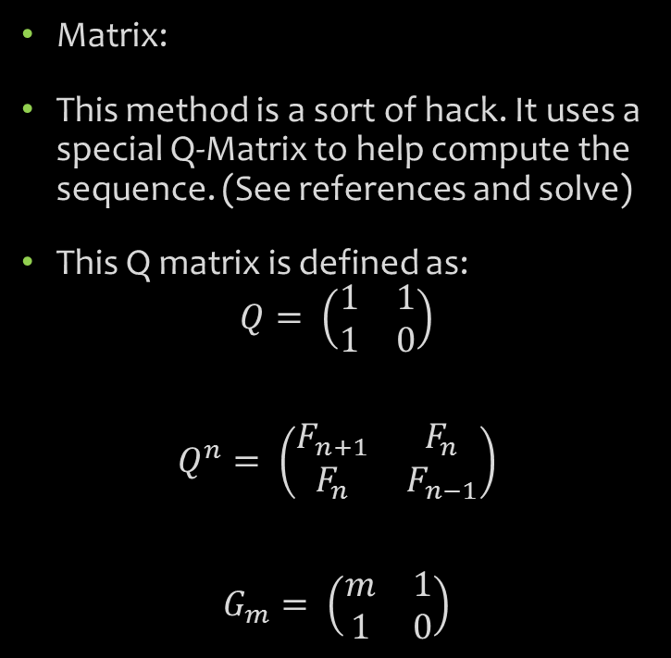
Fibonacci examples using different methods
Recursive:
filename: multiply.m
function y = fib_recur(n)
if n == 0
y = 0;
else
y = [fib_recur(n-1) fib(n)]
end
filename: script.m
count = 5;
ans = fib_recur(count);
Matrix:
This method is a sort of hack. It uses a special Q-Matrix to help compute the sequence. (See references and solve)
This Q matrix is defined as:
$$Q= \left(\begin{matrix}1 & 1 \\ 1 & 0\end{matrix}\right)$$
$$Q^{n}= \left(\begin{matrix}F_{n+1} & F_{n} \\ F_{n} & F_{n−1}\end{matrix}\right)$$
$$G_{m}= \left(\begin{matrix}m & 1 \\ 1 & 0\end{matrix}\right)$$
http://www.cut-the-knot.org/arithmetic/algebra/FibonacciMatrix.shtml
http://www.emis.de/journals/AUA/pdf/16_220_paper-22-20-2009.pdf

